Slide 1

key logger FINAL PROJECT
SUBMITTED BY:
ADDEPALLI. LAKSHMI LAVANYA

Slide 2

KEY LOGGER
Introduction
Problem Statement
Project Overview
End Users
Solution and Value Proposition
The "Wow" Factor in Our Solution
Modelling
Results
Conclusion and Q&A

Slide 3
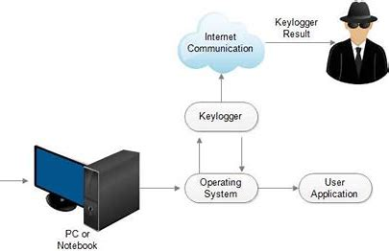
WHAT IS KEYLOGGER
KEYLOGGER

Slide 4

KEY LOGGER
Keyloggers are software tools that record a user's keyboard input, including passwords, credit card numbers, and other sensitive information. They can be used for both legitimate and malicious purposes, making them a powerful but controversial technology.

Slide 5

PROBLEM STATEMENT
Keylogger Threats
Keyloggers pose a serious security risk by secretly recording a user's keyboard input, potentially exposing sensitive information like passwords and financial data.
Lack of User Awareness
Many users are unaware of keylogger threats or lack the knowledge to effectively safeguard their devices and online activities.
Inadequate Security Measures
Existing security solutions may not provide comprehensive protection against sophisticated keylogger attacks, leaving users vulnerable
.

Slide 6

PROJECT OVERVIEW
Objective:
Develop a comprehensive understanding of keyloggers,
their types, how they work, and effective security measures to prevent keylogging attacks.
Scope:
Includes an analysis of hardware and software keyloggers, legal and ethical implications, security measures, and best practices.

Slide 7


WHO ARE THE END USERS?
IT Security Professionals
The primary end users for this keylogger security solution are IT professionals responsible for protecting their organization's networks and devices from cyber threats.
Business Executives
Business leaders and decision- makers who need to safeguard sensitive company data and ensure the overall security of their digital infrastructure will also benefit from this solution.
Remote Employees
With the rise of remote work, this keylogger security tool can help protect employees accessing company systems and data from their personal devices outside the office network.

Slide 8

YOUR SOLUTION AND ITS VALUE PROPOSITION
To avoid keyloggers
Install a reputable antivirus.
Keyloggers can live in several places within a device, making them especially difficult to detect manually.
Update all your apps. Patches and security updates are released for a reason.
Manage permissions.
By logging all keyboard activity, our tool helps users identify and prevent unauthorized access to sensitive information, ensuring their digital privacy is protected.

Slide 9
YOUR SOLUTION AND ITS VALUE PROPOSITION
Solution: Implement a multi-layered security strategy that includes anti-keylogging software, regular system scans, software updates, and user education.
Value Proposition:
Enhanced Security: Reduces the risk of data breaches and identity theft.
User Awareness: Educates users about keylogging threats and protection methods.
Compliance: Helps businesses and organizations comply with data protection regulations.

Slide 10
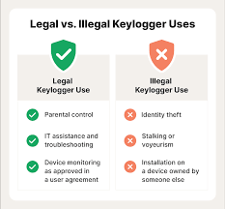
THE WOW IN YOUR SOLUTION
Our security solution goes beyond traditional keylogger detection by leveraging advanced machine learning algorithms to proactively identify and neutralize evolving threats. This cutting-edge technology provides unparalleled protection, delivering a seamless user experience without compromising security.
10

Slide 11
MODELLING
Architecture Overview:
Modular Design: The keylogger code is structured into modular functions for better readability and maintenance.
Event Handling: Utilizes the pynput library to capture and handle keyboard events.
Data Logging: Implements functions to log captured data into text and JSON files.
11

Slide 12



Modelling
Data Gathering
Collect relevant data on user behavior, system logs, and security vulnerabilities to inform the model development process.
Model Training
Train a machine learning model using advanced techniques like deep learning or anomaly detection to identify patterns indicative of keylogger activity.
Feature Engineering
Identify and extract the most relevant features from the data to build a predictive model that can detect and prevent keylogger intrusions.

Slide 13
M0DELLING
Components:
Key Press Handling: Function: on_press(key)
Description: Captures and logs the pressed keys.
Details: Appends key press events to a list and updates the JSON log file.
Key Release Handling: Function: on_release(key)
Description: Captures and logs the released keys.
Details: Appends key release events to a list, updates the JSON log file, and accumulates keys for the text log.
Logging Functions:
Text Logging: generate_text_log(key)
Description: Writes the recorded keys to key_log.txt.
JSON Logging: generate_json_file(keys_used)
Description: Dumps the list of key events to key_log.json.
13

Slide 14
MODELLING
Flow Diagram:
Initialization:
Set up the main GUI window.
Initialize global variables for key logging.
Event Capture:
Start capturing key events when the "Start" button is pressed.
Log key press and release events.
Data Logging:
Continuously update text and JSON log files with captured key events.
Stop Logging:
Stop capturing key events when the “Stop” button is pressed.
Update the GUI status to indicate the keylogger is stopped.
14

Slide 15
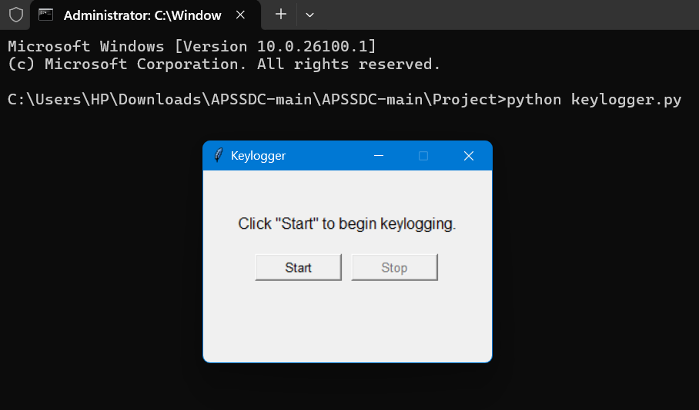
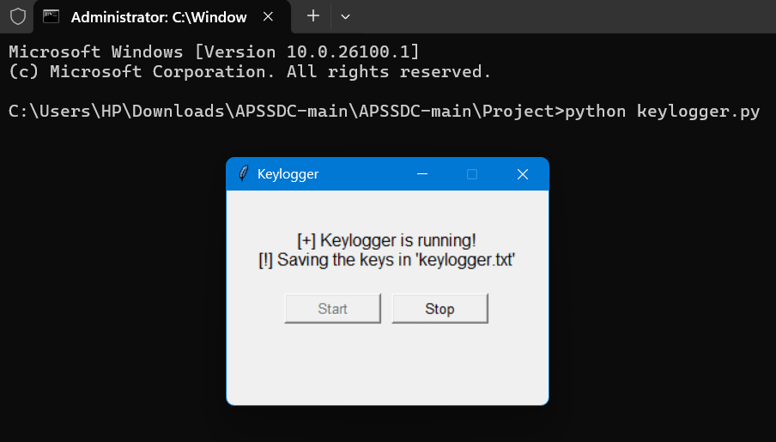
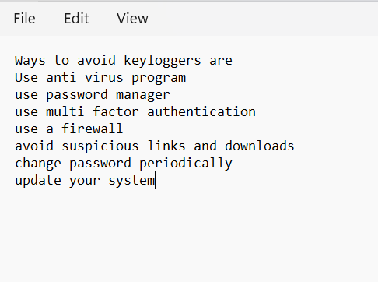
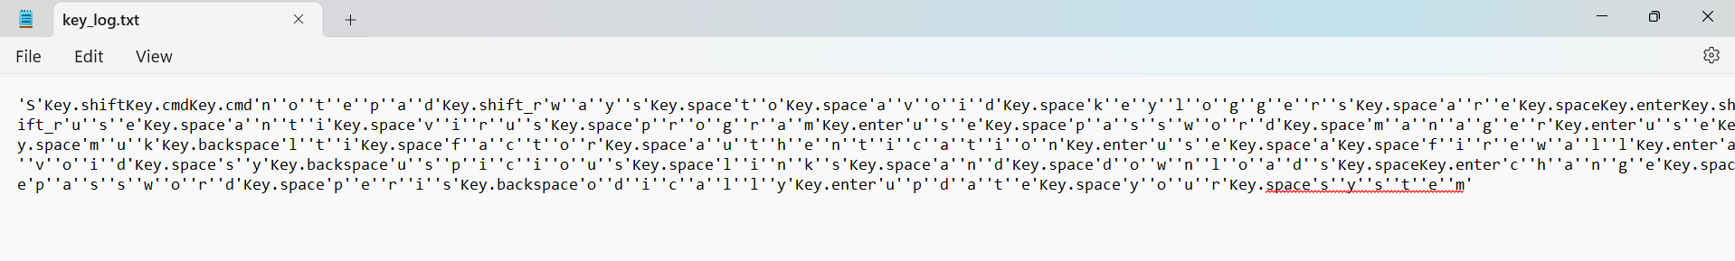
RESULTS
15

Slide 16
RESULTS
Successfully implemented a keylogger that captures keystrokes and records them into both text and JSON files.
Real-time keylogging with start and stop functionality controlled via a simple GUI.
The keylogger project demonstrated the capability to effectively capture and log keystrokes in real-time.
The GUI provided a user-friendly way to control the keylogger, making it accessible and easy to use.
Emphasized the ethical use of keyloggers and the importance of implementing security measures to protect against malicious use.
16

Slide 17
THANKYOU
GITHUB LINK: https://github.com/LAKSHMILAVANYA-A/keylogger

